Slide 1

New Concepts in Conceptual Permitting
Sovereign Lands and
Environmental Resources
Conference (SLERCon)
Michelle K. Hopkins, P.E.
ERP Bureau Chief – Regulation Division
June 10, 2014

Slide 2
SWERP Conceptuals
62-330.055: Conceptual Approval Permits for Urban Infill or Redevelopment
62-330.056: Other Conceptual Approval Permits

Slide 3
Other Conceptual Approval Permits
Approval of Design Concepts for Master Plan
1st Phase of Construction Can Be Included with one application
Issued to Level of Detail Provided
20 Year Duration (if 1st phase of construction starts within 5 yrs)
Future applications to construct must be consistent with the Conceptual Approval Permit, and there must have been:
    No changes to state water quality standards
    No changes to special basin criteria
    No substantive changes to site characteristics

Slide 4
Conceptual Approval Permits for
Urban Infill or Redevelopment
Required by 2013 Statute
Limited to County or Municipality
Urban Infill and Redevelopment Areas or Community Redevelopment Areas created under Chapter 163, FS
Subsequent projects that are consistent may qualify for new GP

Slide 5
Conceptual Approval Permits for
Urban Infill or Redevelopment
Stormwater Master Plan Must:
Identify total contributing basin and sub-basins
Identify receiving waters
Include pre-development annual pollutant loading

Slide 6
Conceptual Approval Permits for
Urban Infill or Redevelopment
Application Must :
Demonstrate net-improvement
Document rate and volume of discharges – existing as of date of permit issuance
Demonstrate perpetual operation and maintenance of stormwater management systems
Estimate extent of impacts to wetlands and other surface waters, and required mitigation
Estimate max impervious surface and provide details of stormwater treatment
Identify activities in SSL’s
Provide a time table for redevelopment and requested permit duration

Slide 7
Conceptual Approval Permits for
Urban Infill or Redevelopment
Conceptual Approval Permit will:
Provide ledger of target pollutant load for each basin
Provide annual pollutant load (mass per area) for each land use category and pollutant removal efficiency of BMP’s. Construction permits will result in ledger debits
Allow rate and volume of discharges up to maximum allowable quantities
Include permit duration up to 20 years, with a possible 10 year extension
Future construction permits – General Permit
62-330.450

Slide 8
General Permit for Urban Infill and Redevelopment (w/Conceptual Approval Permit)
62-330.450
Activities must be within a Chapter 163 designated area
Must include signed/sealed plans and calculations demonstrating net reduction of pollutants as well as documentation of acceptance by the O&M entity;
Agency has 30 days to verify;
Work must comply with CAP;
Agency must calculate pollution removal “credits” deducted from CAP ledger;
Registered professional must submit as-built certification within 30 days of construction completion;
Construction authorized under GP for 5 years, O&M in perpetuity.

Slide 9
City of Plant City
Midtown Stormwater Master Plan
Conceptual Permit No. 49020053.002
Hillsborough County

Slide 10
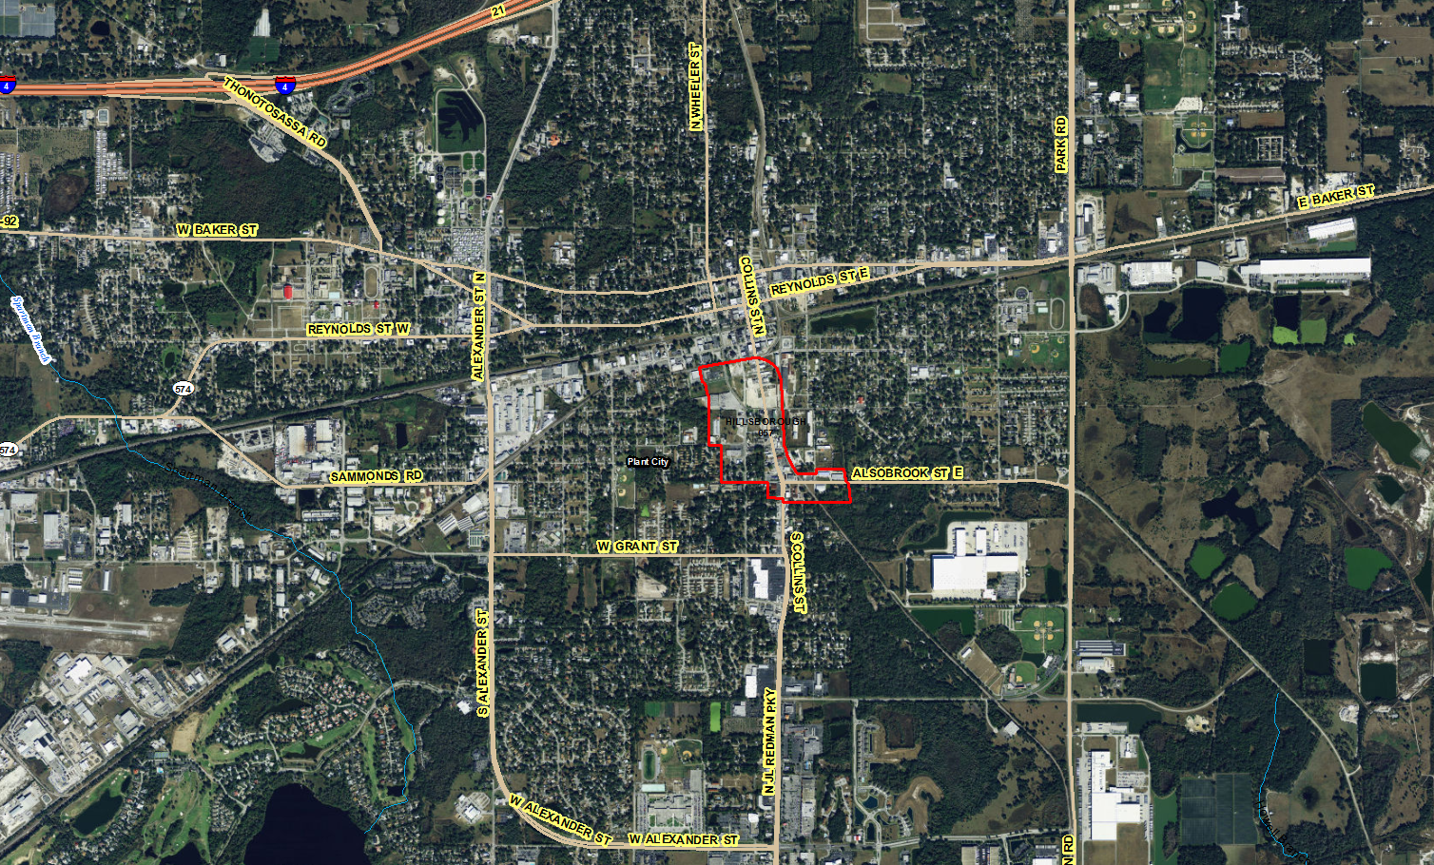

Slide 11
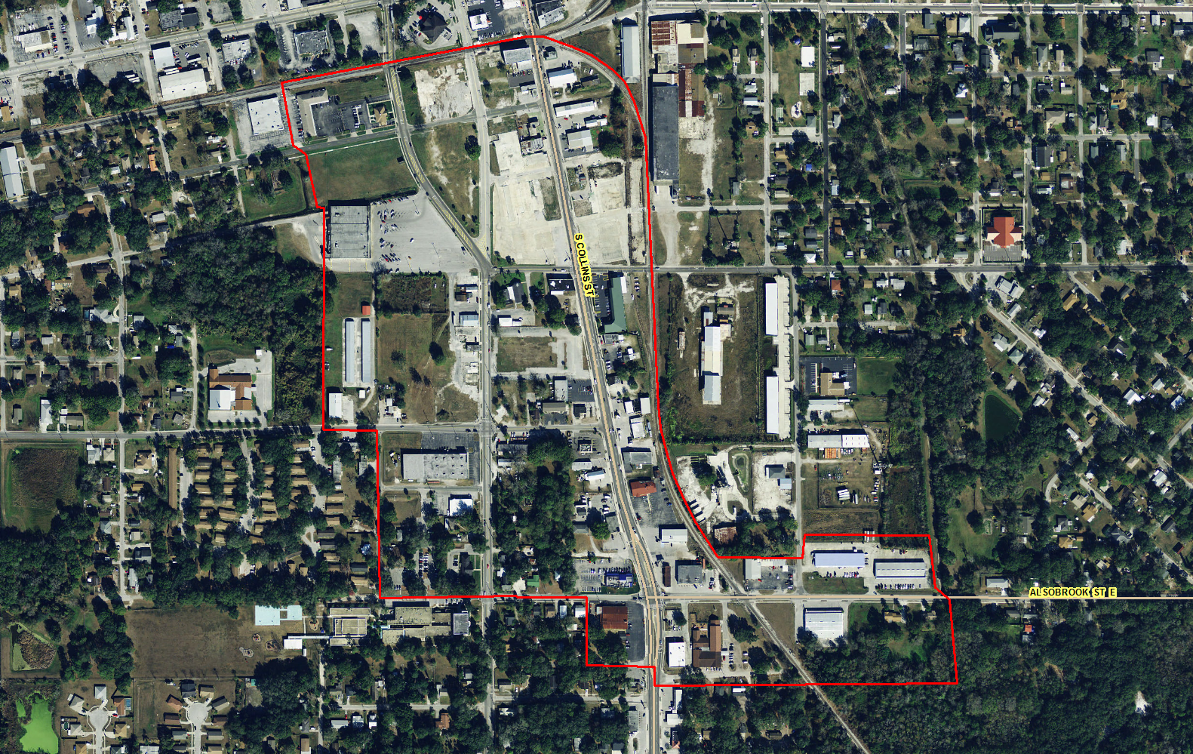

Slide 12
City of Plant City – ERP Conceptual Permit Key Components
40D-4 Conceptual Permit issued July 2011
Redevelopment Area – 94 acres
Receiving Waters – impaired for Total Phosphorus
East and West Drainage Divides
West - BMP’s -Ponds A, B, and Hunter/Grant Street Pond
Total Contributing Basin Area – 240 acres
East – No BMP’s or attenuation
No wetlands or OSW’s identified

Slide 13
City of Plant City – ERP Conceptual Permit Key Components
Future Construction Permits:
Consistent with Conceptual
May provide additional BMP’s for East drainage
Identify extent of wetland/OFW, impacts and mitigation
Maintain ledger of debits/credits on a parcel by parcel basis

Slide 14
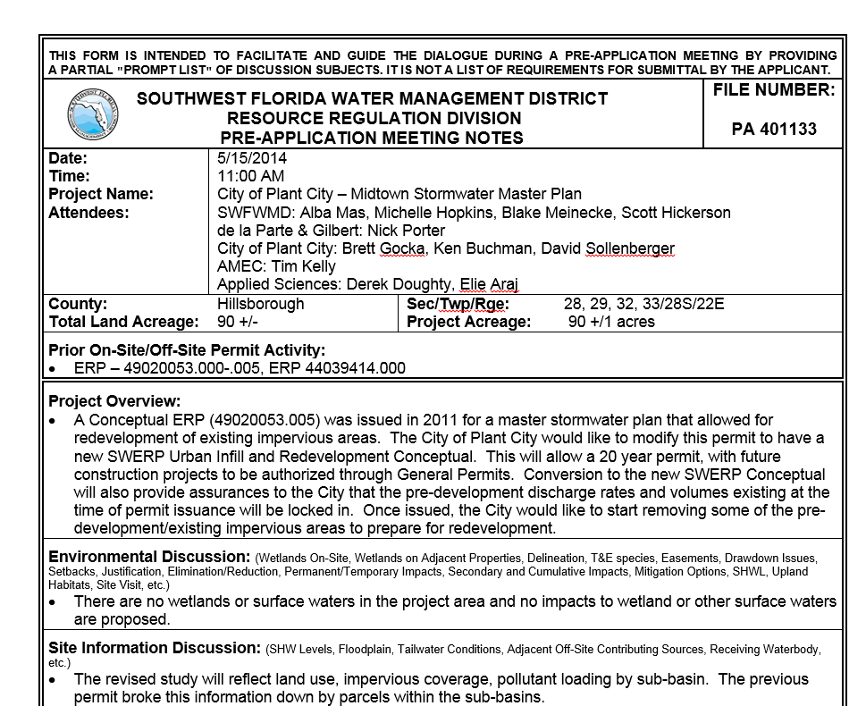
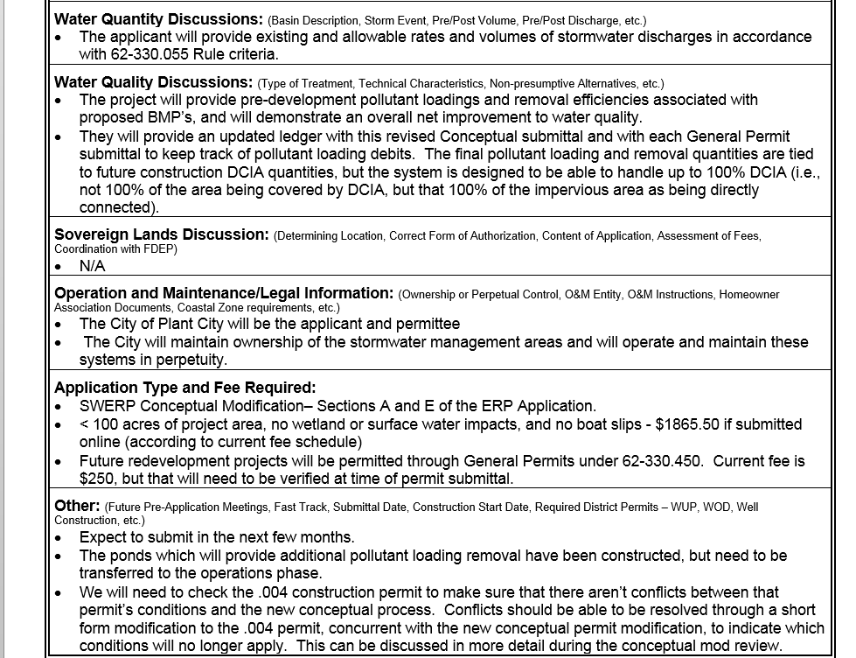
Pre application Meeting – May 2014

Slide 15
City of Plant City – Proposed Conceptual Changes
Convert to Urban Infill and Redevelopment Conceptual
Provides a 20 Year Duration, 10 Year Extension
Assurance of Max Discharge Rates/Volume at time of permitting
Modified Pollutant Load – by Basin not by Parcel More flexibility for City
Updated ledger to reflect allowable basin pollutant load
Future redevelopment – Permit through GP’s

Slide 16
Murdock Village – ERP 49041576.000
Urban Infill and Redevelopment Conceptual Permit
Charlotte County

Slide 17
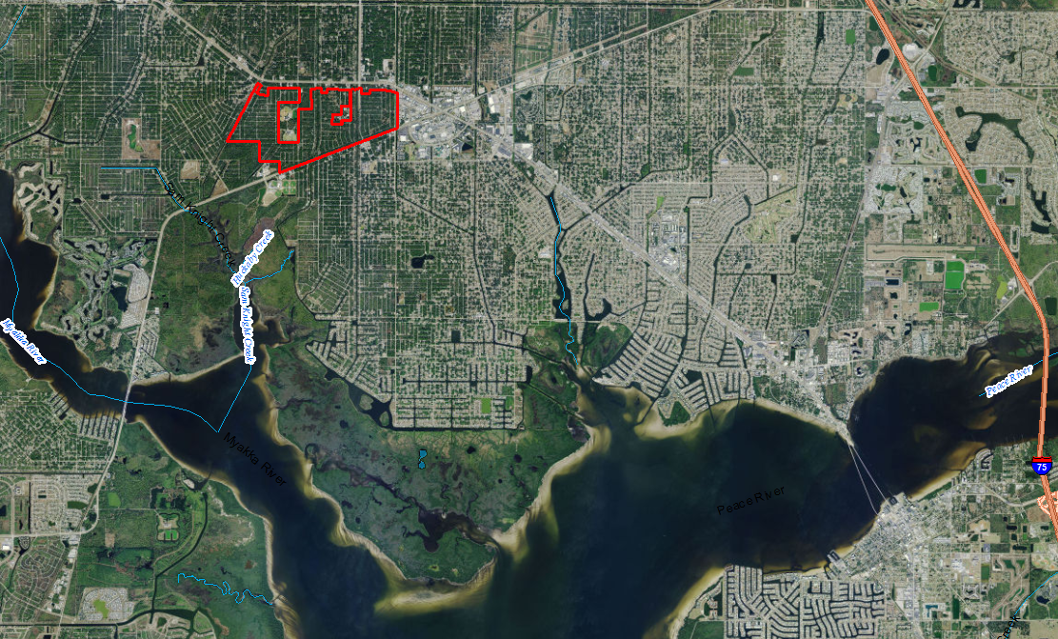

Slide 18
Murdock Village Permit Highlights
Issued April 2014
Project Area – 879 acres
Mixed Use Community
85% Max Impervious Cover per sub-basin
Five Receiving Systems – all with impairments – D.O., nutrients, mercury
Design – based on removal of nutrient and TN
8 Sub-basins and 16 Proposed BMP’s Retention and Wet Detention
Treatment Train
Master ledger for tracking of debits and credits

Slide 19
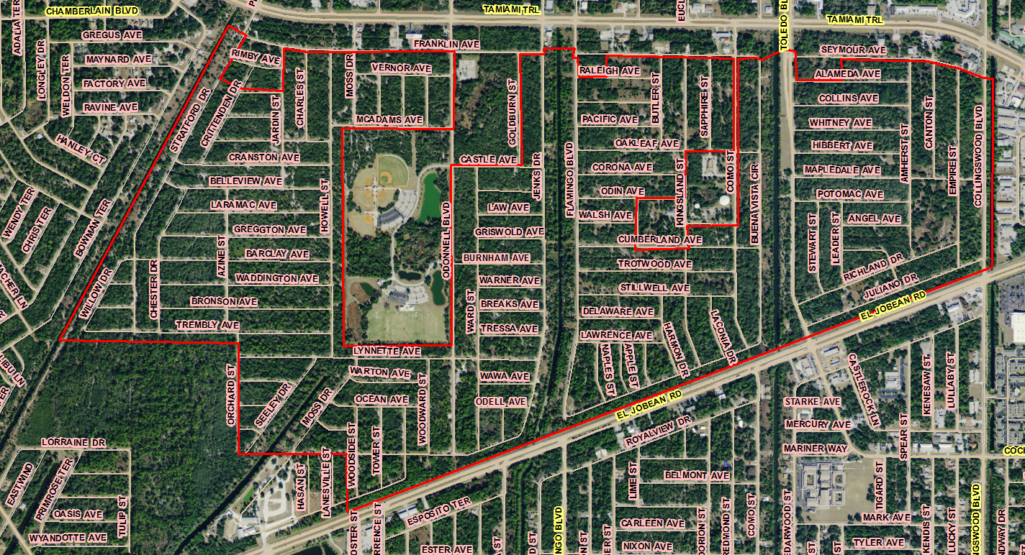

Slide 20
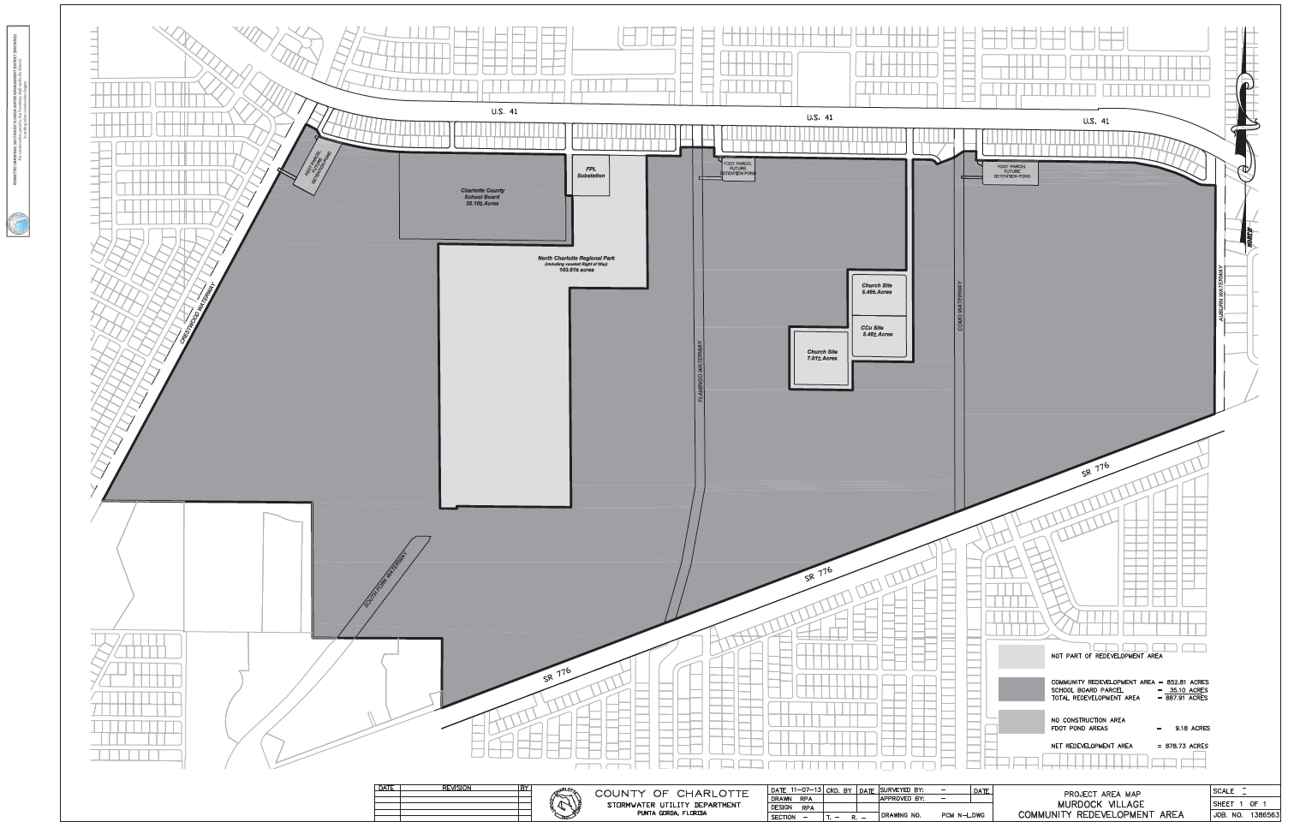

Slide 21
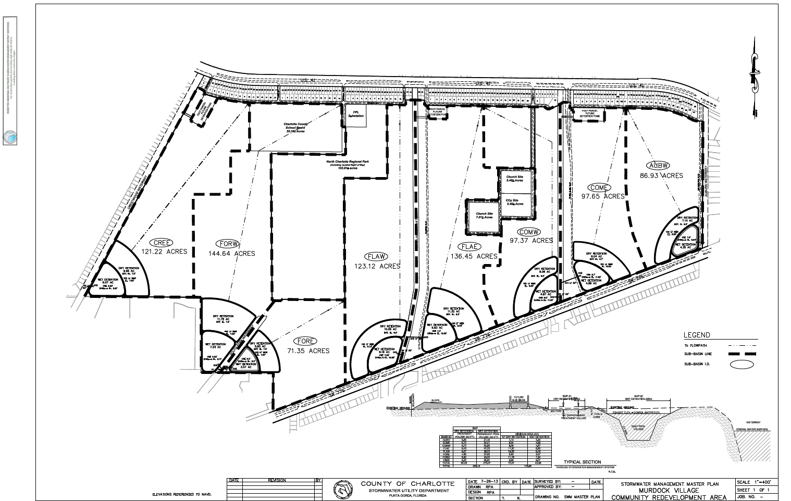

Slide 22
Murdock Village Permit Highlights
7 acres of wetlands and 24 acres of OSW’s – No impacts proposed
Permit Conditioned – Future proposed impacts will require Individual Permit to construct and provide mitigation
UMAM values established for existing conditions
Floodplain limits established – No impacts proposed
Construction of stormwater BMP’s may require Individual Permit, otherwise GP

Slide 23
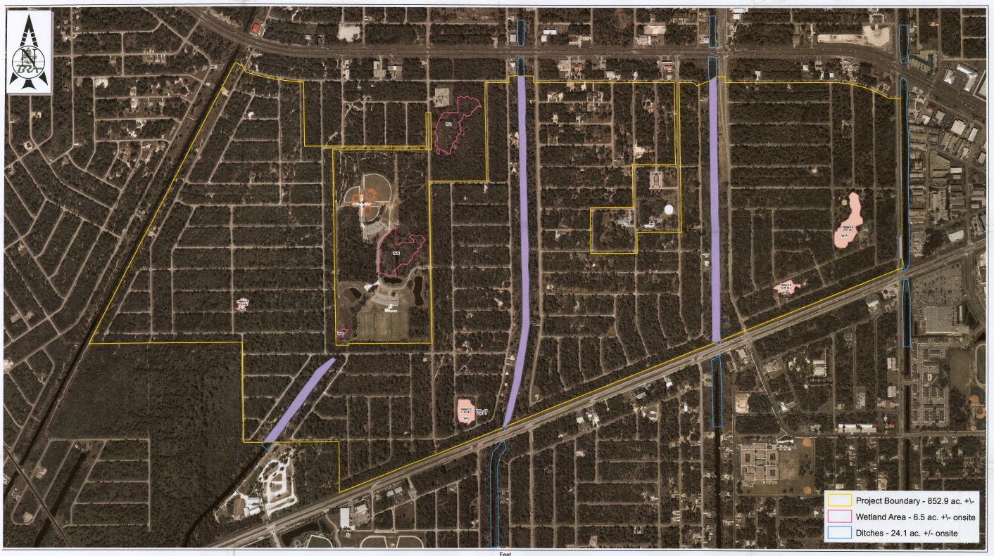

Slide 24
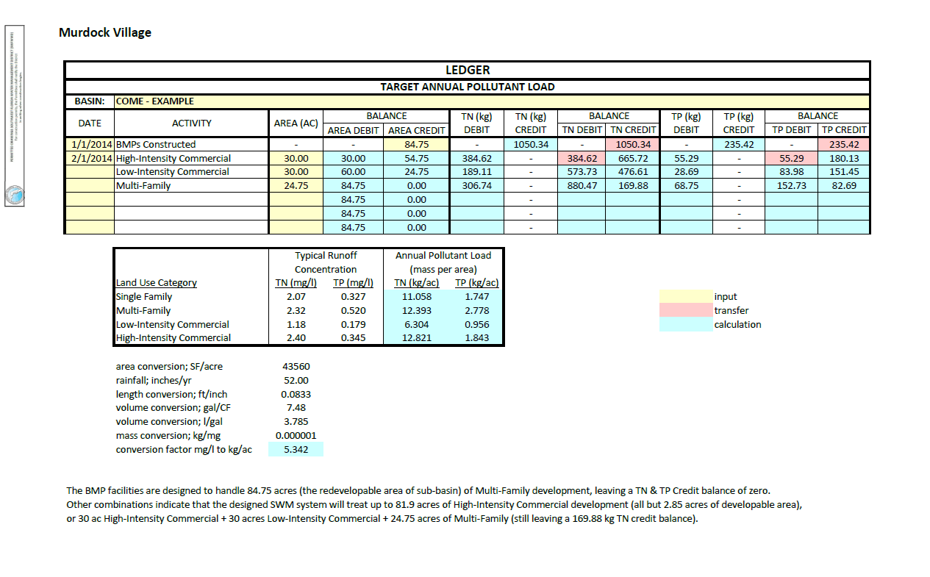

Slide 25
Conceptual Approval Permits for
Urban Infill or Redevelopment
Pending SWERP II Changes
  Impacts to wetlands/OSW’s and related mitigation must be permitted in a separate Individual Permit
  Mitigation for impacts must be initiated prior to approval of a GP relying on the impact/mitigation
  Revised verbiage on permit duration – will be issued for 20 years, unless a shorter duration is requested
  Permit renewals will be for 20 years, unless a shorter duration is requested

Slide 26
Questions/Comments?

